Slide 1
Predicting the difficulty of competitive programming statements
Pop Ioan-Cristian Preoteasa Mircea-Costin Saraev Stefan Sima Radu

Slide 2
Existing work
https://arxiv.org/pdf/2310.05791
Big Bird-based models, grid search for finding the best learning rate
Dataset:
Top 20 most frequent algorithm tags
Difficulty information (Codeforces rating)
Difficulty metrics:
Accuracy
Neighborhood accuracy (difference 3, 5)
Minimum average precision
Tag metrics:
AUROC
F1

Slide 3
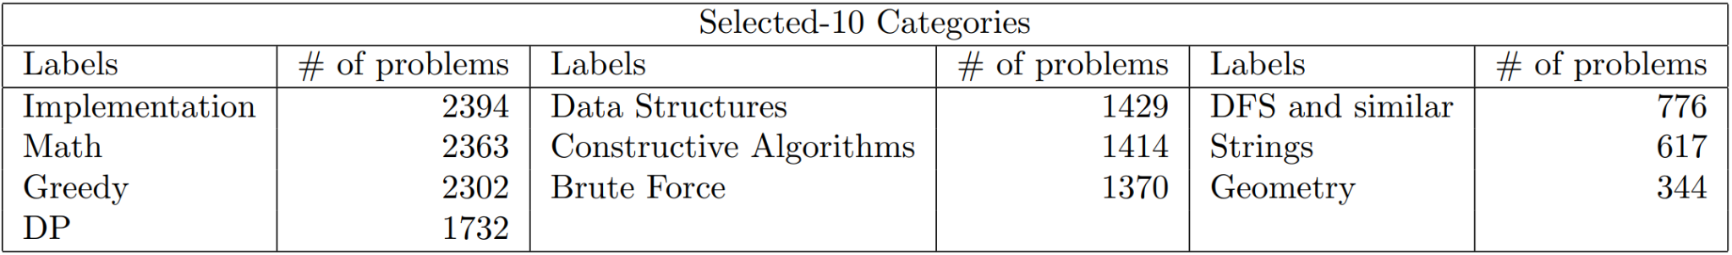
Dataset
AMT10 - Top 10 most frequent categories

Slide 4
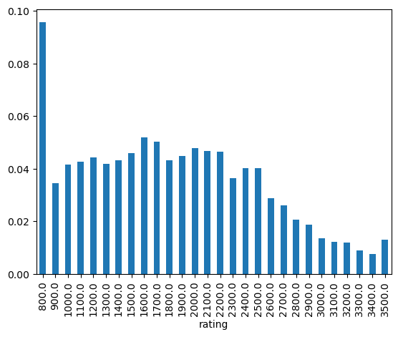
Dataset
AMT10 - distribution of difficulty ratings

Slide 5
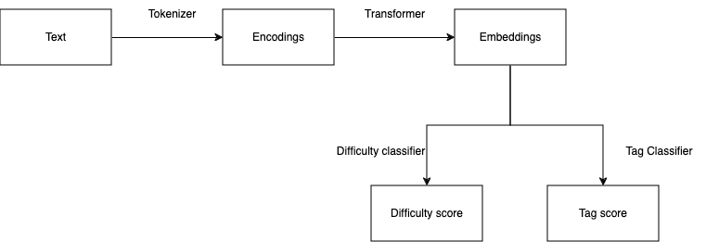
Our work

Slide 6
Our work
Grid search for best classifier architecture (both tag and difficulty rating)
Train transformer with classification head with best architecture found previously
Multiple training iterations, each with new additions
new metrics
metaclasses (for difficulty rating)

Slide 7
Metrics
For the difficulty classifier:
Accuracy
Recall
Precision
F1
Neighborhood accuracy (difference 1, 3, 5)
Mean average precision
For the tag classifier:
Accuracy
Recall
Precision
F1
Mean average precision

Slide 8
Classifier heads used
For the difficulty classifier:
Multiclass classification
Ordinal regression classification
For the tag classifier:
Multiclass classification

Slide 9
Classifier techniques for better performance
Ordinal regression classification:
Variable threshold (grid search)
Greedy threshold
Multiclass classification:
Variable threshold (grid search)
Greedy threshold

Slide 10
Results Difficulty classification
Reference: Accuracy 0.1, NA3 0.2, NA5 0.3
Transformer used | Threshold | Num classes | Accuracy | F1 | Neighborhood Accuracy 1 | Neighborhood Accuracy 3 | Neighborhood Accuracy 5
roberta-base | 0.4 | 5 | 0.23 | 0.17 | 0.67
roberta-base | 0.3 | 28 | 0.03 | 0.02 | 0.1 | 0.19 | 0.27
roberta-large | 0.2 | 5 | 0.25 | 0.19 | 0.7
roberta-large | 0.35 | 28 | 0.04 | 0.02 | 0.1 | 0.2 | 0.31

Slide 11
Results Tag classification
Reference: F1 0.5
Transformer used | Threshold | Accuracy | F1 | mAP
roberta-base | 0.3 | 0.1 | 0.15 | 0.23
roberta-large | 0.4 | 0.1 | 0.15 | 0.27

Slide 12
Demo

Slide 13
Thank you!

